Slide 1
Map Reduce Programming

Slide 2
Contents
Map-Reduce Programming
Exercises
Mappers & Reducers
Hadoop combiners
Hadoop partitioners

Slide 3
Overview
Hadoop MapReduce is a software framework for easily writing applications which process vast amounts of data (multi-terabyte data-sets) in-parallel on large clusters (thousands of nodes) of commodity hardware in a reliable, fault-tolerant manner.
A MapReduce job usually splits the input data-set into independent chunks which are processed by the map tasks in a completely parallel manner.
The framework sorts the outputs of the maps, which are then input to the reduce tasks.
Typically both the input and the output of the job are stored in a file-system.
The framework takes care of scheduling tasks, monitoring them and re-executes the failed tasks.

Slide 4
Typically the compute nodes and the storage nodes are the same, that is, the MapReduce framework and the Hadoop Distributed File System are running on the same set of nodes.
This configuration allows the framework to effectively schedule tasks on the nodes where data is already present, resulting in very high aggregate bandwidth across the cluster.
The MapReduce framework consists of a single master Resource Manager, one worker NodeManager per cluster-node, and MRAppMaster per application

Slide 5
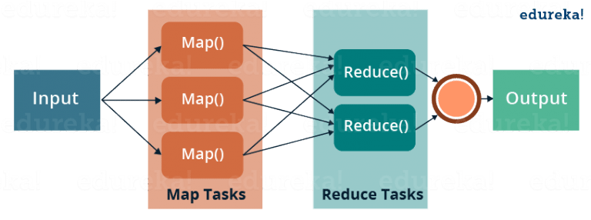
What is Map Reduce?

Slide 6
Word count Job
Input : Text file
Output : count of words
Hi how are you
how is your job
how is your family
how is your sister
How is your brother
what is the time now
what is the strength of the Hadoop
Hi how are you?
how is your job?
how is your family
how is your sister
how is your brother
what is the time now
what is the strength of the Hadoop
File.txt
Size :: 500MB

Slide 7
Text Input format
Key Value Text Input Format
Sequence File Input Format
SequenceFileAsTextInput Format
Input file
Input split 1
Input split 1
Input split 1
Input split 1
Record reader
Record reader
Record reader
Record reader
Byteoffset , record
Mapper
Mapper
Mapper
Mapper
Because of collection framework , as it doesnot work on the primitive types, wrapper classes are created.
Collection framework Work with the object to type so object of wrapper class is to be created. Similar to Java as it has introduced wrapper class corresponding to primitive class. Hadoop has introduced Box classes.
For Java conversion from primitive to wrapper is done automatically but for Hadoop we need to explicitly mention that conversion.
Int -→ new IntWritable(int) and get () method for back
Primitive types
int
long
float
double
string
char
etc…
Wrapper Class
Integer
Long
Float
Double
String
Character
etc..
Box Class
IntWritable
LongWritable
FloatWritable
DoubleWritable
StringWritable
CharWritable
etc..
Notes:
Because of collection framework , as it doesnot work on the primitive types, wrapper classes are created. Collection framework
Work with the object to type so object of wrapper class is to be created. Similar to Java as it has introduced wrapper class corresponding to primitive class. Hadoop has introduced Box classes.
For Java conversion from primitive to wrapper is done automatically but for Hadoop we need to explicitly mention that conversion.
Int -→ new IntWritable(int) and get () method for back

Slide 8
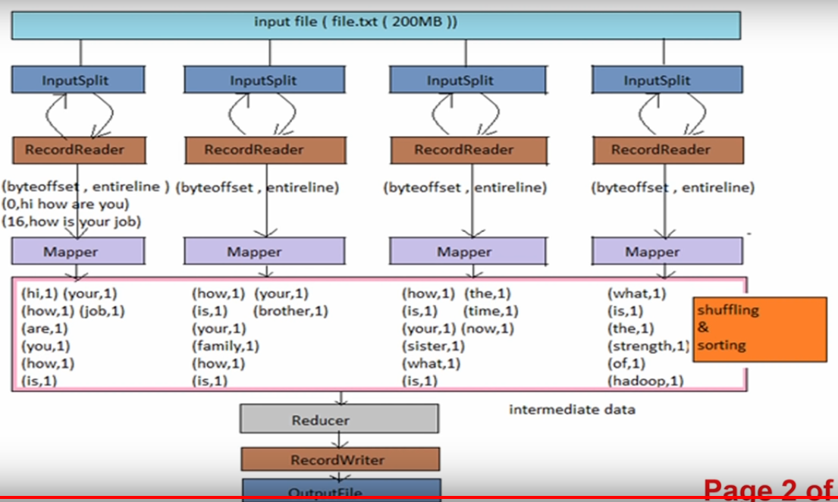
400 MB

Slide 9
Basic Idea
Issue: Copying data over a network takes time
Idea: ▪
Bring computation to data
Store files multiple times for reliability
MapReduce addresses these problems
Storage Infrastructure – File system ▪
Google: GFS.
Hadoop: HDFS
Programming model ▪
MapReduce
NEXT

Slide 10
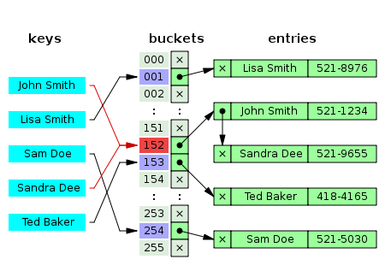
Recall HashTable
Hash Function maps input keys to buckets.

Slide 11
From HashTable to Distributed Hash Table (DHT)
Node-1
Node-2
...
Node-n
Disibuted Hash Function maps input keys to physical nodes.

Slide 12
From DHT to MapReduce
Node-1
Node-2
...
Node-n
Map()
Reduce()

Slide 13
The MapReduce programming model
MapReduce is a distributed programming model
In many circles, considered the key building block for much of Google’s data analysis
A programming language built on it: Sawzall, http://labs.google.com/papers/sawzall.html
… Sawzall has become one of the most widely used programming languages at Google. … [O]n one dedicated Workqueue cluster with 1500 Xeon CPUs, there were 32,580 Sawzall jobs launched, using an average of 220 machines each. While running those jobs, 18,636 failures occurred (application failure, network outage, system crash, etc.) that triggered rerunning some portion of the job. The jobs read a total of 3.2x10¹⁵ bytes of data (2.8PB) and wrote 9.9x10¹² bytes (9.3TB).
Other similar languages: Yahoo’s Pig Latin and Pig; Microsoft’s Dryad
Cloned in open source: Hadoop, http://hadoop.apache.org/

Slide 14
The MapReduce programming model
Simple distributed functional programming primitives
Modeled after Lisp primitives:
map (apply function to all items in a collection) and
reduce (apply function to set of items with a common key)
We start with:
A user-defined function to be applied to all data, map: (key,value) → (key, value)
Another user-specified operation reduce: (key, {set of values}) → result
A set of n nodes, each with data
All nodes run map on all of their data, producing new data with keys
This data is collected by key, then shuffled, and finally reduced
Dataflow is through temp files on GFS

Slide 15
Simple example: Word count
map(String key, String value) { // key: document name, line no // value: contents of line }
reduce(String key, Iterator values) { }
// key: a word // values: a list of counts int result = 0; for each v in values: result += ParseInt(v); emit(key, result)
for each word w in value: emit(w, "1")
Goal: Given a set of documents, count how often each word occurs
Input: Key-value pairs (document:lineNumber, text)
Output: Key-value pairs (word, #occurrences)
What should be the intermediate key-value pairs?

Slide 16
Simple example: Word count
Key range the node is responsible for
(apple, {1, 1, 1})
(apple, 3)
Mapper (1-2)
(apple, 1)
(apple, 1)
(apple, 1)
Reducer (A-G)
(an, 2)
(an, 1)
(an, 1)
(an, {1, 1})
(because, 1)
(1, the apple)
(because, 1)
(because, {1})
(green, 1)
(2, is an apple)
(green, 1)
(green, {1})
(3, not an orange)
Mapper (3-4)
(is, 1)
(is, 1)
(is, {1, 1})
Reducer (H-N)
(is, 2)
(not, 1)
(not, 1)
(not, {1, 1})
(not, 2)
(4, because the)
(5, orange)
(orange, 1)
(orange, 1)
(orange, 1)
(orange, 3)
(orange, {1, 1, 1})
Mapper (5-6)
Reducer (O-U)
(6, unlike the apple)
(the, 1)
(the, 1)
(the, 1)
(the, {1, 1, 1})
(the, 3)
(7, is orange)
(unlike, 1)
(unlike, {1})
(unlike, 1)
(8, not green)
Mapper (7-8)
Reducer (V-Z)
2
The reducers process their input one group at a time
1
The mappers process the KV-pairs one by one
Each KV-pair output by the mapper is sent to the reducer that is responsible for it
5
Each mapper receives some of the KV-pairs as input
3
4
The reducers sort their input by key and group it

Slide 17
MapReduce: A Diagram

Slide 18
MapReduce: In Parallel

Slide 19
Steps of MapReduce
3 steps of MapReduce
Sequentially read a lot of data
Map: Extract something you care about
Group by key: Sort and shuffle
Reduce: Aggregate, summarize, filter or transform
Output the result

Slide 20
MapReduce Examples #example1
word count using MapReduce
map(keyin, valuein,keyout,valueout):
// key: document name; value: text of document
for each word w in value:
emit(w, 1)
reduce(keyin, values):
// key: a word; values: an iterator over counts
result = 0
for each count v in values:
result += v
emit(key, result)
(hi,1)(how,1)(hi,1)(you,1)
(hi,(1,1))

Slide 21
counting words of different lengths#example2
Input file :
hi how are you?
Welcome to Nirma University.
Output file :
2: 2 , 3:3 , 5:1, 7:1 , 10:1
How??
hi:2, how:3, are:3, you:3,welcome:7,to:2,Nirma:5,University:10

Slide 22
Mapper Task :
Emit(2,hi),(2,to)(3,how)………
Reducer Task :
(2:[hi,to])
(3:[how,are,you])
……

Slide 23

Find out the word length histogram#example3
particular document is given and then we have to, find out that how many big medium and small words are
appearing in the particular document and this becomes the word length histogram.

Slide 24

Big : Yellow : 10+
Medium: Red : 5 to 9
Small: Blue : 2to 4
Tiny: pink : 1

Slide 25


Slide 26
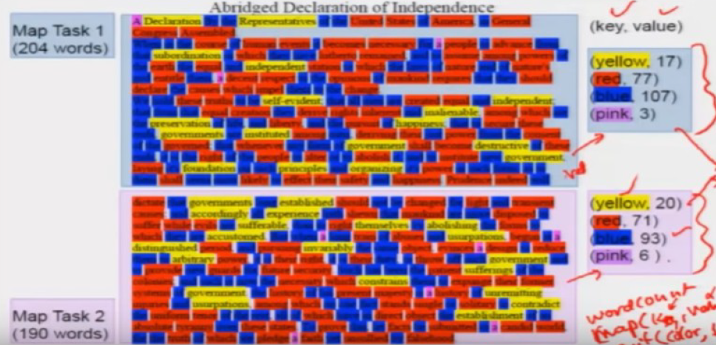

Slide 27
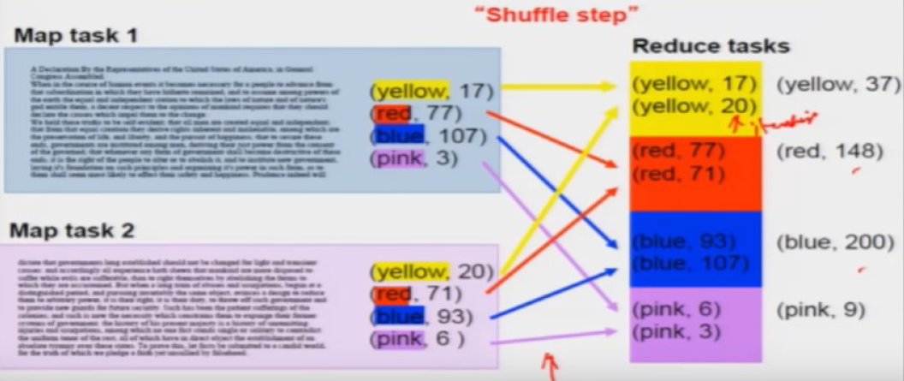

Slide 28
Inverted Index #example4
Finding given word from search engine
Input:
Tweet1, “I love pancakes for breakfast”
Tweet2, “I dislike pancakes”
Tweet3, “What should I eat for breakfast?”
Tweet4, “I love to eat”
Output:
Pancakes(tweet1,tweet2)
Breakfast(tweet1,tweet3)
eat(tweet3,tweet4)
love(tweet1,tweet4)
Find out Mapper and Reducer

Slide 29
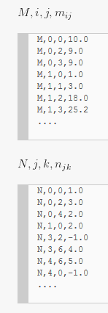
Matrix Multiplication#example5
Input Format

Slide 30
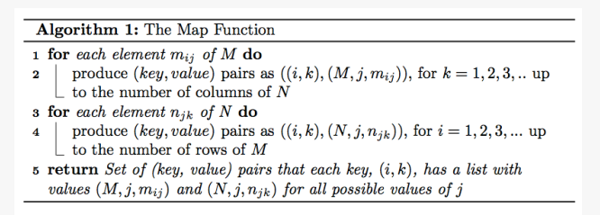
Map Function

Slide 31
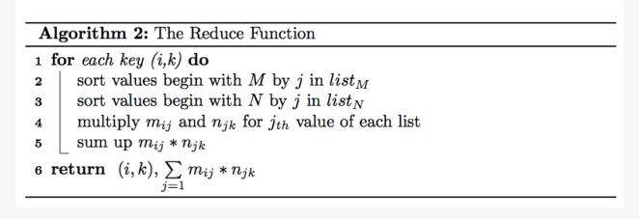

Slide 32
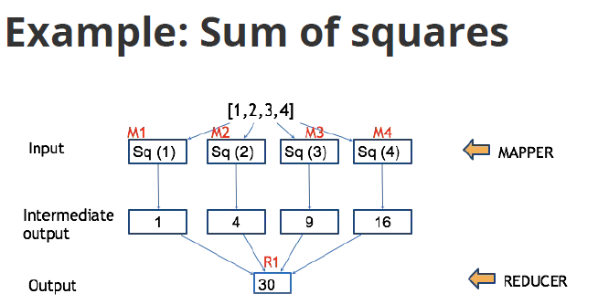

Slide 33
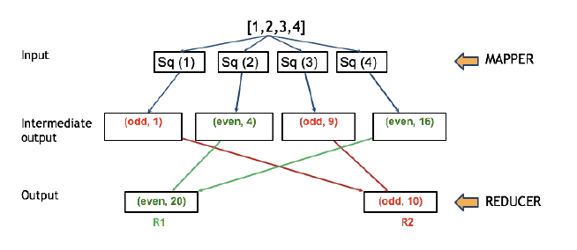
Sum of even numbers and sum of odd numbers of squares of a given number list

Slide 34
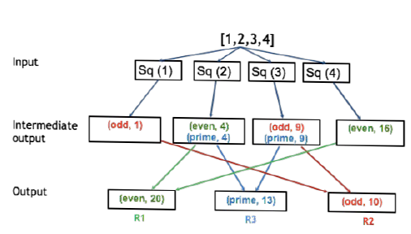
Sum of even numbers , sum of odd numbers and sum of prime numbers of squares of a given number list

Slide 35
In Detail
Hadoop Mapper
Hadoop Reducer
Key-Value Pairs
Input Format
Record Reader
Partitioner

Slide 36
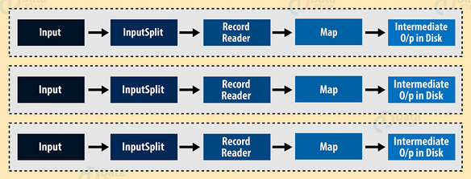
Mapper in Hadoop Map-Reduce

Slide 37
How is key value pair generated in Hadoop?
Input Split
Record Reader

Slide 38
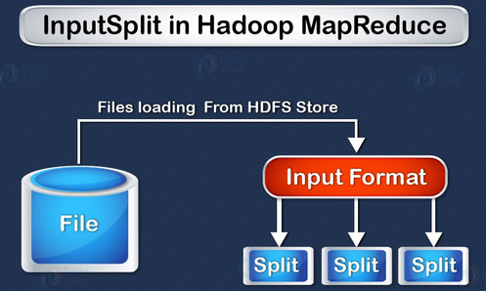
InputSplit
InputSplit in Hadoop MapReduce is the logical representation of data. It describes a unit of work that contains a single map task in a MapReduce program.
As a user, we don’t need to deal with InputSplit directly, because they are created by an InputFormat
mapred.min.split.size parameter in mapred-site.xml we can control this value or by overriding the parameter in the Job object used to submit a particular MapReduce job.

Slide 39
The client (running the job) can calculate the splits for a job by calling ‘getSplit()’, and then sent to the application master, which uses their storage locations to schedule map tasks that will process them on the cluster.
Then, map task passes the split to the createRecordReader() method on InputFormat to get RecordReader for the split and RecordReader generate record (key-value pair), which it passes to the map function.

Slide 40
public abstract class InputFormat<K, V>
{
public abstract List<InputSplit> getSplits(JobContext context)
throws IOException, InterruptedException;
public abstract RecordReader<K, V>
createRecordReader(InputSplit split, TaskAttemptContext context) throws IOException,
InterruptedException;
}

Slide 41
What is Hadoop InputFormat?
The InputFormat class is one of the fundamental classes in the Hadoop MapReduce framework which provides the following functionality:
The files or other objects that should be used for input is selected by the InputFormat.
InputFormat defines the Data splits, which defines both the size of individual Map tasks and its potential execution server.
InputFormat defines the RecordReader, which is responsible for reading actual records from the input files.

Slide 42
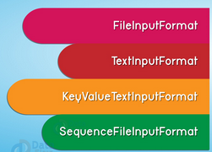
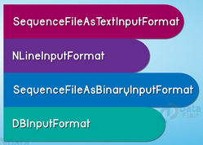
Types of InputFormat in MapReduce

Slide 43
1. FileInputFormat
It is the base class for all file-based InputFormats.
FileInputFormat also specifies input directory which has data files location.
When we start a MapReduce job execution, FileInputFormat provides a path containing files to read.
This InpuFormat will read all files. Then it divides these files into one or more InputSplits.

Slide 44
2. TextInputFormat
It is the default InputFormat. This InputFormat treats each line of each input file as a separate record. It performs no parsing. TextInputFormat is useful for unformatted data or line-based records like log files. Hence,
Key – It is the byte offset of the beginning of the line within the file (not whole file one split). So it will be unique if combined with the file name.
Value – It is the contents of the line. It excludes line terminators.

Slide 45
3. KeyValueTextInputFormat
It is similar to TextInputFormat. This InputFormat also treats each line of input as a separate record.
While the difference is that TextInputFormat treats entire line as the value, but the KeyValueTextInputFormat breaks the line itself into key and value by a tab character (‘/t’). Hence,
Key – Everything up to the tab character.
Value – It is the remaining part of the line after tab character.

Slide 46
4. SequenceFileInputFormat
It is an InputFormat which reads sequence files.
Sequence files are binary files.
These files also store sequences of binary key-value pairs. These are block-compressed and provide direct serialization and deserialization of several arbitrary data.
Key & Value both are user-defined.

Slide 47
5. SequenceFileAsTextInputFormat
It is the variant of SequenceFileInputFormat. This format converts the sequence file key values to Text objects. So, it performs conversion by calling ‘tostring()’ on the keys and values.
Hence, SequenceFileAsTextInputFormat makes sequence files suitable input for streaming.
6. SequenceFileAsBinaryInputFormat
By using SequenceFileInputFormat we can extract the sequence file’s keys and values as an opaque binary object.

Slide 48
7. NlineInputFormat
It is another form of TextInputFormat where the keys are byte offset of the line. And values are contents of the line. So, each mapper receives a variable number of lines of input with TextInputFormat and KeyValueTextInputFormat.
The number depends on the size of the split. Also, depends on the length of the lines. So, if want our mapper to receive a fixed number of lines of input, then we use NLineInputFormat.
N- It is the number of lines of input that each mapper receives.
By default (N=1), each mapper receives exactly one line of input.
Suppose N=2, then each split contains two lines. So, one mapper receives the first two Key-Value pairs. Another mapper receives the second two key-value pairs.

Slide 49
8. DBInputFormat
This InputFormat reads data from a relational database, using JDBC. It also loads small datasets, perhaps for joining with large datasets from HDFS using MultipleInputs. Hence,
Key – LongWritables
Value – DBWritables.

Slide 50
Where to mention?
Driver code
job.setInputFormatClass(DBInputFormat.class);
job.setOutputFormatClass(DBOutputFormat.class);

Slide 51
Record Reader
The MapReduce RecordReader in Hadoop takes the byte-oriented view of input, provided by the InputSplit and presents as a record-oriented view for Mapper.
Map task passes the split to the createRecordReader() method on InputFormat in task tracker to obtain a RecordReader for that split. The RecordReader load’s data from its source and converts into key-value pairs suitable for reading by the mapper.

Slide 52
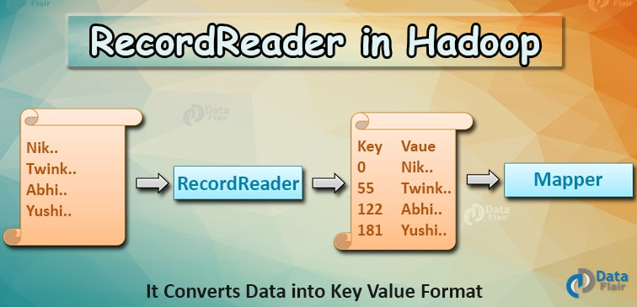

Slide 53
Types of Hadoop Record Reader in MapReduce
i. LineRecordReader
ii. SequenceFileRecordReader
Maximum size for a Single Record
conf.setInt("mapred.linerecordreader.maxlength", Integer.MAX_VALUE);
A line with a size greater than this maximum value (default is 2,147,483,647) will be ignored.

Slide 54
Hadoop Record Writer
Record Writer writes these output key-value pairs from the Reducer phase to output files.
TextOutputFormat
SequenceFileOutputFormat
SequenceFileAsBinaryOutputFormat
MapFileOutputFormat
MultipleOutputs
LazyOutputFormat
DBOutputFormat

Slide 55
Java Programs for Word count Problem
Driver Code
Mapper Code
Reducer Code

Slide 56
import java.io.IOException;
import java.util.StringTokenizer;
import org.apache.hadoop.conf.Configuration;
import org.apache.hadoop.fs.Path;
import org.apache.hadoop.io.IntWritable;
import org.apache.hadoop.io.Text;
import org.apache.hadoop.mapreduce.Job;
import org.apache.hadoop.mapreduce.Mapper;
import org.apache.hadoop.mapreduce.Reducer;
import org.apache.hadoop.mapreduce.lib.input.FileInputFormat;
import org.apache.hadoop.mapreduce.lib.output.FileOutputFormat;
public class WordCount {
public static class TokenizerMapper extends Mapper<Object, Text, Text, IntWritable>{
private final static IntWritable one = new IntWritable(1);
private Text word = new Text();
public void map(Object key, Text value, Context context) throws IOException, InterruptedException {
StringTokenizer itr = new StringTokenizer(value.toString());
while (itr.hasMoreTokens()) {
word.set(itr.nextToken());
context.write(word, one);
}
}
}

Slide 57
public static class IntSumReducer extends Reducer<Text,IntWritable,Text,IntWritable> {
private IntWritable result = new IntWritable();
public void reduce(Text key, Iterable<IntWritable> values,Context context) throws IOException, InterruptedException {
int sum = 0;
for (IntWritable val : values) {
sum += val.get();
}
result.set(sum);
context.write(key, result);
}
}
public static void main(String[] args) throws Exception {
Configuration conf = new Configuration();
Job job = Job.getInstance(conf, "word count");
job.setJarByClass(WordCount.class);
job.setMapperClass(TokenizerMapper.class);
//job.setCombinerClass(IntSumReducer.class);
job.setReducerClass(IntSumReducer.class);
job.setOutputKeyClass(Text.class);
job.setOutputValueClass(IntWritable.class);
FileInputFormat.addInputPath(job, new Path(args[0]));
FileOutputFormat.setOutputPath(job, new Path(args[1]));
System.exit(job.waitForCompletion(true) ? 0 : 1);
}
}

Slide 58
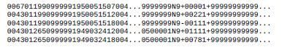
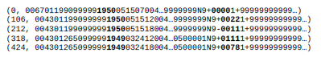
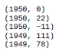
NCDC data
Raw Format of weather data
Mapper Input data
Mapper Output data

Slide 59

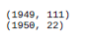
Reducer Input data
Reducer Output data

Slide 60
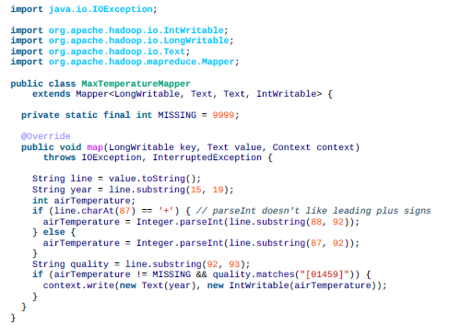

Slide 61
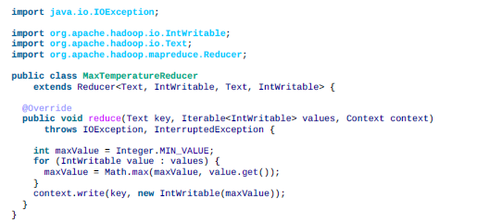

Slide 62
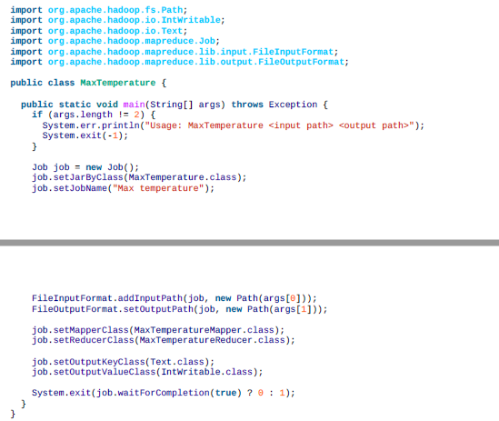

Slide 63
Hadoop/Map Reduce Combiners
On a large dataset when we run MapReduce job, large chunks of intermediate data is generated by the Mapper and this intermediate data is passed on the Reducer for further processing, which leads to enormous network congestion. MapReduce framework provides a function known as Hadoop Combiner that plays a key role in reducing network congestion
The combiner in MapReduce is also known as ‘Mini-reducer’. The primary job of Combiner is to process the output data from the Mapper, before passing it to Reducer. It runs after the mapper and before the Reducer and its use is optional
Notes:
Hadoop Combiner is also known as “Mini-Reducer” that summarizes the Mapper output record with the same Key before passing to the Reducer. MapReduce combiner we are going to answer what is a Hadoop combiner, MapReduce program with and without combiner, advantages of Hadoop combiner and disadvantages of the combiner in Hadoop.

Slide 64
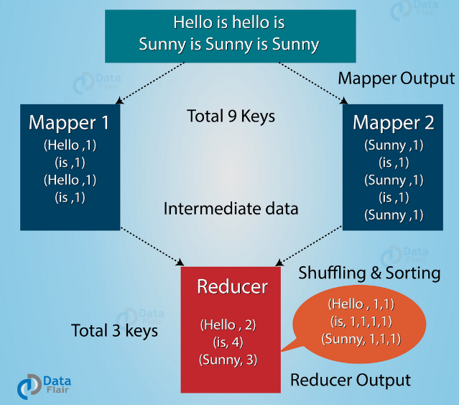
MapReduce program without Combiner

Slide 65
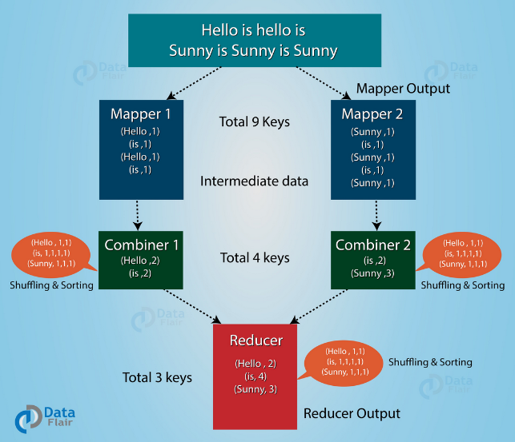
MapReduce program with Combiner

Slide 66
Disadvantages of MapReduce Combiner
Advantages of MapReduce Combiner
Hadoop Combiner reduces the time taken for data transfer between mapper and reducer.
It decreases the amount of data that needed to be processed by the reducer.
The Combiner improves the overall performance of the reducer.
MapReduce jobs cannot depend on the Hadoop combiner execution because there is no guarantee in its execution.
In the local filesystem, the key-value pairs are stored in the Hadoop and run the combiner later which will cause expensive disk IO.

Slide 67
Where to define it?
In Driver class
job. Set Combiner Class(ReduceClass.class);
Separate java file
public class Combiners Hadoop {

Slide 68
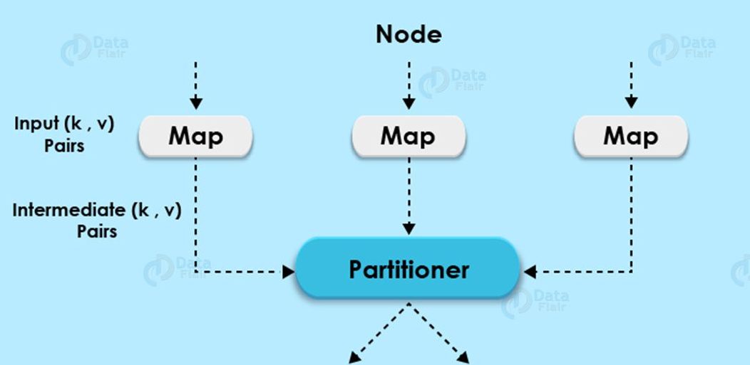
Hadoop Partitioner / MapReduce Partitioner
Partitioning of the keys of the intermediate map output is controlled by the Partitioner.
Notes:
The Partitioner in MapReduce controls the partitioning of the key of the intermediate mapper output. By hash function, key (or a subset of the key) is used to derive the partition. A total number of partitions depends on the number of reduce task. Here we will also learn what is the need of Hadoop partitioner, what is the default Hadoop partitioner, how many practitioners are required in Hadoop and what do you mean by poor partitioning in Hadoop along with ways to overcome MapReduce poor partitioning.

Slide 69
Need of Hadoop MapReduce Partitioner
MapReduce job takes an input data set and produces the list of the key-value pair which is the result of map phase in which input data is split and each task processes the split and each map, output the list of key-value pairs. Then, the output from the map phase is sent to reduce task which processes the user-defined reduce function on map outputs.
Before reduce phase, partitioning of the map output take place on the basis of the key and sorted.

Slide 70
This partitioning specifies that all the values for each key are grouped together and make sure that all the values of a single key go to the same reducer, thus allows even distribution of the map output over the reducer.
Partitioner in Hadoop MapReduce redirects the mapper output to the reducer by determining which reducer is responsible for the particular key.
The Default Hadoop partitioner in Hadoop MapReduce is Hash Partitioner which computes a hash value for the key and assigns the partition based on this result.

Slide 71
How many Partitioner
The total number of Partitioners that run in Hadoop is equal to the number of reducers i.e. Partitioner will divide the data according to the number of reducers which is set by JobConf.setNumReduceTasks() method.
Thus, the data from single Partitioner is processed by a single reducer. And Partitioner is created only when there are multiple reducers

Slide 72
Poor Partitioning in Hadoop MapReduce
If in data input one key appears more than any other key then
The key appearing more will be sent to one partition.
All the other key will be sent to partitions according to their hashCode().
If hashCode() method does not uniformly distribute other keys data over partition range, then data will not be evenly sent to reducers.
Poor partitioning of data means that some reducers will have more data input than other i.e. they will have more work to do than other reducers. So, the entire job will wait for one reducer to finish its extra-large share of the load.
we can create Custom partitioner, which allows sharing workload uniformly across different reducers.

Slide 73
Partitioner provides the getPartition() method that you can implement yourself if you want to declare the custom partition for your job.
public static class MyPartitioner extends Partitioner<Text,Text>{ public int getPartition(Text key, Text value, int numReduceTasks){ if(numReduceTasks==0) return 0; if(key.equals(new Text(“Male”)) ) return 0; if(key.equals(new Text(“Female”))) return 1; } }

Slide 74
How to set number of reducers?
By default no of reducer=1
If you mention JobConf.setNumReduceTasks(0) then no of reducers are 0 and process will be executed only using mappers. No sorting& shuffling will applied
Methods to set no of reducers
Command line (bin/hadoop jar -Dmapreduce.job.maps=5 yourapp.jar..)
mapred.map.tasks --> mapreduce.job.maps
mapred.reduce.tasks --> mapreduce.job.reduces
In the code, one can configure JobConf variables.
job.setNumMapTasks(5); // 5 mappers
job.setNumReduceTasks(2); // 2 reducers

